Slide 1
Chapter 10: File-System Interface

Slide 2
Chapter 10: File-System Interface
File Concept
Access Methods
Directory Structure
File-System Mounting
File Sharing
Protection

Slide 3
Objectives
To explain the function of file systems
To describe the interfaces to file systems
To discuss file-system design tradeoffs, including access methods, file sharing, file locking, and directory structures
To explore file-system protection

Slide 4
10.1 File Concept
Contiguous logical address space
File is an abstract data type
Definition
  A file is a named collection of related information that is recorded on secondary storage.
Types:
  Data
    numeric
    character
    binary
  Program

Slide 5
10.1.1 File Attributes
Name – only information kept in human-readable form
Identifier – unique tag (number) identifies file within file system
Type – needed for systems that support different types
Location – pointer to file location on device
Size – current file size
Time, date, and user identification – data for protection, security, and usage monitoring
Protection – controls who can do reading, writing, executing

Slide 6
File Attributes (Cont.)
The information about files are kept in the directory structure, which is maintained on the disk
Discussion：
  文件的这些属性存放在什么位置？（文件目录表、FCB、Inode）
    UNIX中称为索引节点（inode的概念及引入的原因）
  文件在磁盘上的位置如何表示？（由物理文件的类型决定）

Slide 7
10.1.2 File Operations
File is an abstract data type
  Create
  Write
  Read
  Reposition within file
  Delete
  Truncate
  Open(F_{i}) – search the directory structure on disk for entry F_{i}, and move the content of entry to memory
  Close (F_{i}) – move the content of entry F_{i} in memory to directory structure on disk

Slide 8
Open Files
Several pieces of data are needed to manage open files:
  File pointer: pointer to last read/write location, per process that has the file open
  File-open count: counter of number of times a file is open – to allow removal of data from open-file table when last processes closes it
  Disk location of the file: cache of data access information
  Access rights: per-process access mode information

Slide 9
Open & close
文件打开基本过程或基本思想
  fd=open(“文件名”)
  fd的含义
  FCB
  AFCB（Active FCB）
1. 根据文件名查找目录项，如果目录项不在内存中，则从硬盘上读取该目录项
2. 根据目录项找到FCB，读入全局打开文件表
3. 在进程的局部打开文件表中建立指向全局打开文件表中的相应项的指针
4. Open() 返回该文件在局部打开文件表中的偏移
关闭文件的基本过程或基本思想

Slide 10
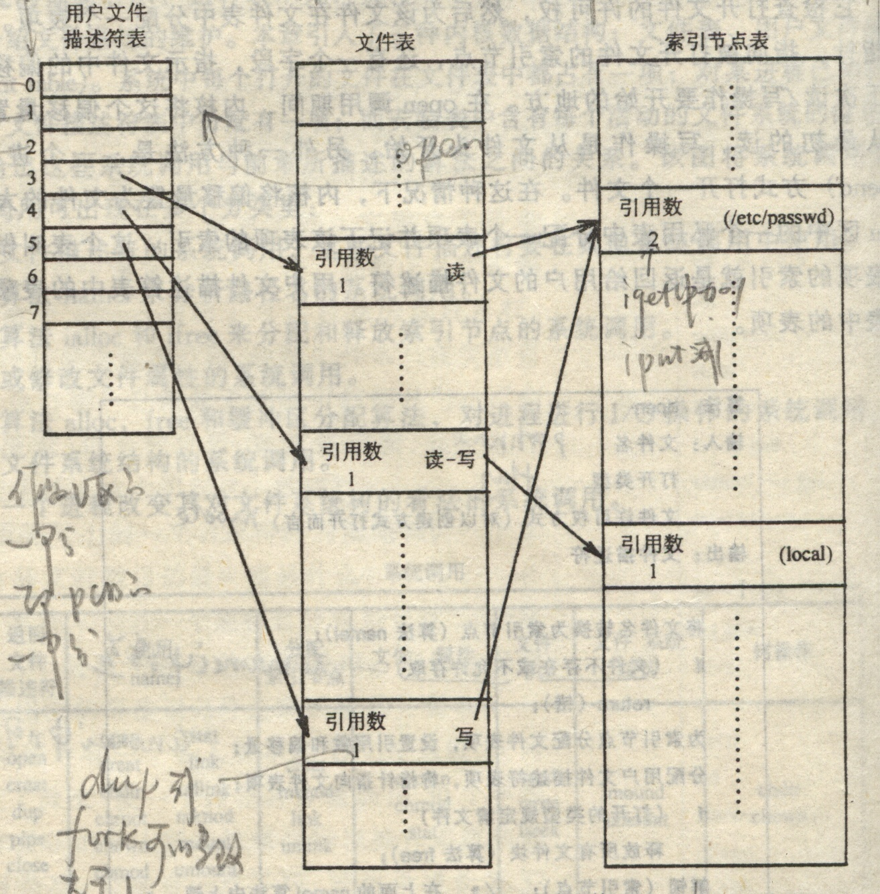
打开文件后的数据结构

Slide 11
Open File Locking
File locks allow one process to lock an open file and prevent other processes from gaining access to it. (reader-writer problem)
Useful for file sharing (eg. Log file)
Shared lock & exclusive lock
  shared lock— reader lock
  exclusive lock – writer lock
Provided by some operating systems and file systems
Mediates access to a file
Mandatory or advisory:
  Mandatory – access is denied depending on locks held and requested
  Advisory – processes can find status of locks and decide what to do

Slide 12
File Locking Example – Java API
import java.io.*;
import java.nio.channels.*;
public class LockingExample {
public static final boolean EXCLUSIVE = false;
public static final boolean SHARED = true;
public static void main(String arsg[]) throws IOException {
FileLock sharedLock = null;
FileLock exclusiveLock = null;
try {
RandomAccessFile raf = new RandomAccessFile("file.txt", "rw");
// get the channel for the file
FileChannel ch = raf.getChannel();
// this locks the first half of the file - exclusive
exclusiveLock = ch.lock(0, raf.length()/2, EXCLUSIVE);
/** Now modify the data . . . */
// release the lock
exclusiveLock.release();

Slide 13
File Locking Example – Java API (cont)
// this locks the second half of the file - shared
sharedLock = ch.lock(raf.length()/2+1, raf.length(), SHARED);
/** Now read the data . . . */
// release the lock
sharedLock.release();
} catch (java.io.IOException ioe) {
System.err.println(ioe);
}finally {
if (exclusiveLock != null)
exclusiveLock.release();
if (sharedLock != null)
sharedLock.release();
}
}
}

Slide 14

10.1.3 File Types – Name, Extension

Slide 15
10.1.4 File Structure
Source and object files have structures that match the expectations of the programs that read them.
Further, certain files must conform to a required structure that is understood by the operating system.
None - sequence of words, bytes （流式文件）
Simple record structure
  Lines
  Fixed length
  Variable length
Complex Structures
  Formatted document
  Relocatable load file (可执行文件)
    An executable file have a specific structure so that it can determine where in memory to load the file and what the location of the first instruction is..

Slide 16
File Structure(Cont.)
Can simulate last two with first method by inserting appropriate control characters
Who decides:
  Operating system
  Program

Slide 17
10.1.5 Internal File Structure
All disk I/O is performed in units of one block (physical record), and all blocks are the same size
  磁盘的物理块大小一般是一个扇区大小或者是扇区的整数倍
It is unlikely that the physical record size will exactly match the length of the desired logical record
Logical records may even vary in length
Packing a number of logical records into physical blocks is a common solution to this problem
Internal fragmentation

Slide 18
Internal File Structure (Cont.)
The UNlX operating system defines all files to be simply streams of bytes
Each byte is individually addressable by its offset from the beginning (or end) of the file.
In this case, the logical record size is 1 byte.
Suppose the physical disk block size is 512 bytes
The file system automatically packs and unpacks bytes into physical disk blocks (512bytes) as necessary.

Slide 19
磁盘的逻辑块与物理块
文件系统将磁盘视为一个逻辑空间，该逻辑空间就象一个大的数组，数组的每个元素是文件系统操作的基本单位—逻辑块
逻辑块是从0开始编址且逻辑块是连续的
逻辑块的大小一般是扇区大小的2^{n}
物理块是数据在磁盘上的存取单位，也就是每进行一次I/O操作，最小传输的数据大小
一般情况下，一个物理块对应一个扇区 （有时也对应多个）

Slide 20
10.2 Access Methods
Sequential Access
read next
write next
reset
no read after last write
(rewrite)
Direct Access
read n
write n
position to n
read next
write next
rewrite n
n = relative block number
Other Access Methods (Index)
  Other access methods can be built on top of cl direct-access method. These methods generally involve the construction of an index for the file.

Slide 21

Sequential-access File

Slide 22
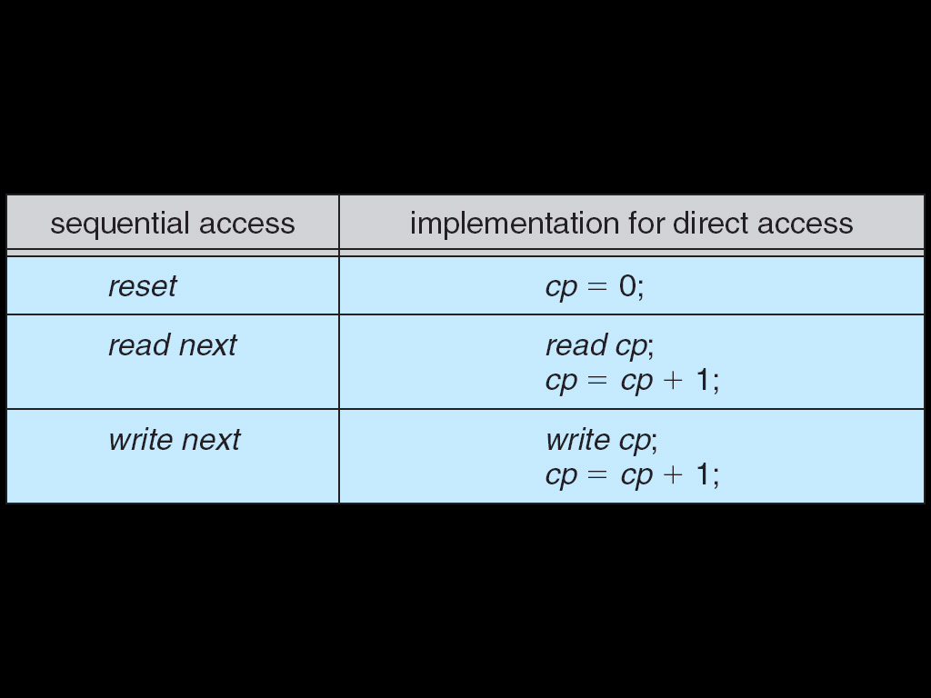
Simulation of Sequential Access on a Direct-access File

Slide 23

Example of Index and Relative Files

Slide 24
10.3 Directory Structure
Some systems store millions of files on terabytes of disk.
To manage all these data, we need to organize them.
This organization involves the use of directories.
Directory -- A collection of nodes containing information about all files
System may have zero or more file systems, and the file systems may be of varying types.
Format 可以创建文件系统；
Format做了哪些工作？

Slide 25

A Typical File-system Organization
10.3.1 Storage Structure

Slide 26
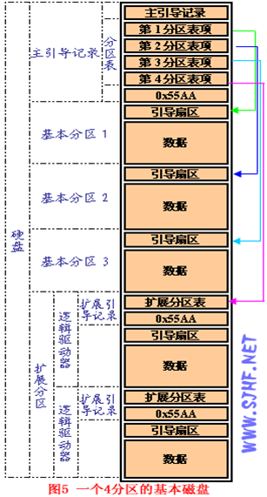
一个四分区的磁盘布局

Slide 27

MS-DOS Disk Layout

Slide 28

在分区上创建的FAT32文件系统结构

Slide 29
创建一个文件系统所做的工作（UNIX）
引导块（boot block）
  占据文件系统的开始，一般是一个扇区
  含有被读入机器中起引导或初启OS的引导代码
  每个文件系统都有一个引导块（可能是空的）
超级块
  文件系统的规模（多大空间）
  文件系统空闲块的数目
  文件系统中可用的空闲块表（链表的表头）
  文件系统中下一个空闲块的下标
  索引节点表的大小
  文件系统中空闲索引节点的数目
  文件系统中空闲索引节点表
  空闲索引节点表中下一个空闲索引节点的下标
  空闲块表的锁字段和空闲索引节点表锁字段
  指明超级块被修改过的标记
索引节点表
数据块
引导块
超级块
索引节点表
数据块

Slide 30
10.3.2 Directory Overview
A collection of nodes containing information about all files
Directory
Files
F 1
F 2
F 3
F 4
F n
Both the directory structure and the files reside on disk
Backups of these two structures are kept on tapes

Slide 31
Directory– just files
Unix中将目录视为文件，称为目录文件，目录文件中的内容是目录表
目录表
Inode—Index node, FCB(File Control Block)
有一个根索引节点，对应根目录
FCB
文件名 | 扩展名 | … | … | … | … | 文件位置
文件名 | 索引结点号

Slide 32
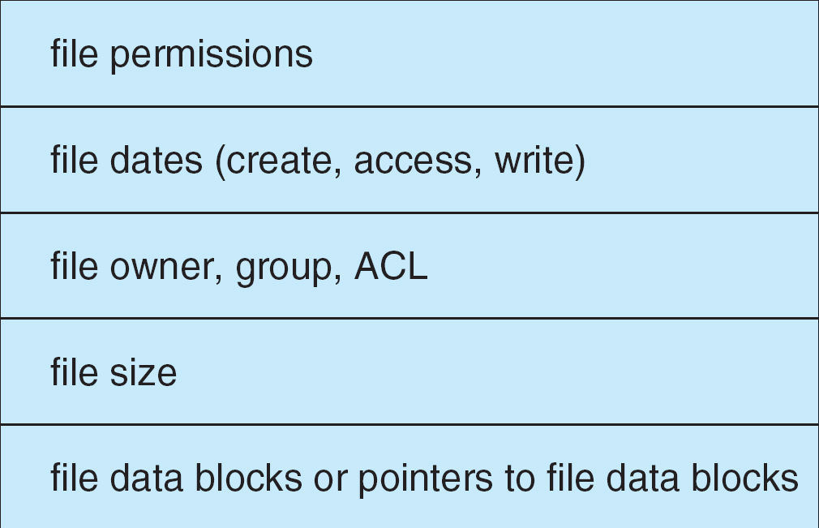
A Typical File Control Block

Slide 33
Ext2 文件系统的索引节点
struct ext2_inode {
__u16 i_mode; /* 文件类型和访问权限 */
__u16 i_uid; /* 文件拥有者标识号*/
__u32 i_size; /* 以字节计的文件大小 */
__u32 i_atime; /* 文件的最后一次访问时间 */
__u32 i_ctime; /* 该节点最后被修改时间 */
__u32 i_mtime; /* 文件内容的最后修改时间 */
__u32 i_dtime; /* 文件删除时间 */
__u16 i_gid; /* 文件的用户组标志符 */
__u16 i_links_count; /* 文件的硬链接计数 */
__u32 i_blocks; /* 文件所占块数（每块以512字节计）*/
__u32 i_flags; /* 打开文件的方式 */
union /*特定操作系统的信息*/
__u32 i_block[Ext2_N_BLOCKS]; /* 指向数据块的指针数组 */
__u32 i_version; /* 文件的版本号（用于 NFS） */
__u32 i_file_acl; /*文件访问控制表（已不再使用） */
__u32 i_dir_acl; /*目录 访问控制表（已不再使用）*/
__u8 l_i_frag; /* 每块中的片数 */
__u32 i_faddr; /* 片的地址 */
union /*特定操作系统信息*/
}

Slide 34
Operations Performed on Directory
Search for a file
Create a file
Delete a file
List a directory
Rename a file
Traverse the file system

Slide 35
Organize the Directory (Logically) to Obtain
Efficiency – locating a file quickly
Naming – convenient to users
  Two users can have same name for different files
  The same file can have several different names
Grouping – logical grouping of files by properties, (e.g., all Java programs, all games, …)
File sharing

Slide 36

10.3.3 Single-Level Directory
A single directory for all users
Efficient searching
Naming problem
Grouping problem
File sharing problem

Slide 37

10.3.4 Two-Level Directory
Separate directory for each user
Path name
Can have the same file name for different user
Efficient searching
Grouping problem
File sharing problem

Slide 38

10.3.5 Tree-Structured Directories
File sharing problem

Slide 39
Tree-Structured Directories (Cont)
Efficient searching
Grouping Capability
File sharing problem
Current directory (working directory)
  cd /spell/mail/prog
  type list

Slide 40
Tree-Structured Directories (Cont)
Absolute or relative path name
Creating a new file is done in current directory
Delete a file
rm <file-name>
Creating a new subdirectory is done in current directory
  mkdir <dir-name>
Example: if in current directory /mail
mkdir count
mail
prog
copy
prt
exp
count
Deleting “mail” ⇒ deleting the entire subtree rooted by “mail”

Slide 41

10.3.6 Acyclic-Graph Directories
Have shared subdirectories and files

Slide 42
Acyclic-Graph Directories (Cont.)
File sharing: Two different names (aliasing)
Problems
  共享文件有多条绝对路径，遍历文件系统时可能重复计数
  删除共享文件时，可能造成其他共享该文件的路径留下悬空指针；
    若该指针可能指向实际的磁盘地址，而该空间又被其他文件使用，指向错误文件的错误部分
Solutions:
  符号链接文件（UNIX）(Widows中的快捷方式)
  Backpointers, so we can delete all pointers
  Backpointers using a daisy chain organization
  Entry-hold-count solution(链接计数)
  hard link（UNIX）
    Link – another name (pointer) to an existing file
    Resolve the link – follow pointer to locate the file

Slide 43

10.3.7 General Graph Directory

Slide 44
General Graph Directory (Cont.)
How do we guarantee no cycles?
  Allow only links to file not subdirectories
  Garbage collection
  Every time a new link is added use a cycle detection algorithm to determine whether it is OK

Slide 45
10.4 File System Mounting
A file system must be mounted before it can be accessed
A unmounted file system (i.e. Fig. 11-11(b)) is mounted at a mount point
使用U盘(USB硬盘)之前需要mount；
拔出U盘(USB硬盘)之前需要unmount；

Slide 46

(a) Existing. (b) Unmounted Partition

Slide 47
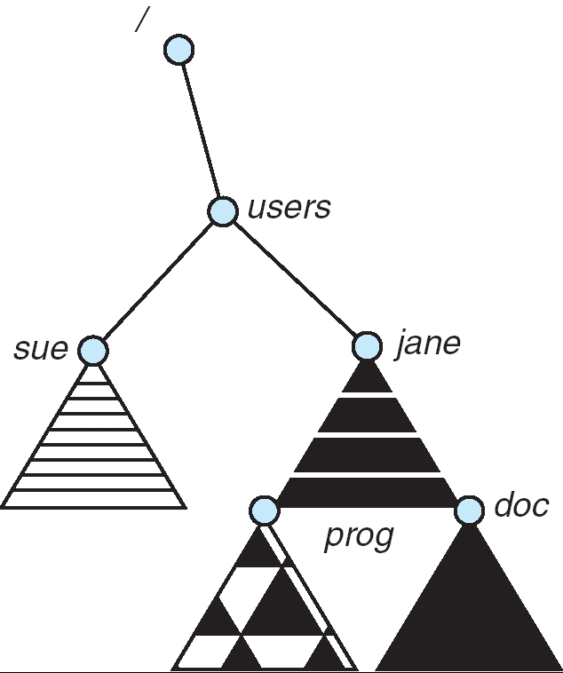
Mount Point
Mount
Point

Slide 48
10.5 File Sharing
Sharing of files on multi-user systems is desirable
Sharing may be done through a protection scheme
On distributed systems, files may be shared across a network
Network File System (NFS) is a common distributed file-sharing method

Slide 49
10.5.1 File Sharing – Multiple Users
User IDs identify users, allowing permissions and protections to be per-user
Group IDs allow users to be in groups, permitting group access rights

Slide 50
10.5.2 File Sharing – Remote File Systems
Uses networking to allow file system access between systems
  Manually via programs like FTP
  Automatically, seamlessly using distributed file systems
  Semi automatically via the world wide web
Client-server model allows clients to mount remote file systems from servers
  Server can serve multiple clients
  Client and user-on-client identification is insecure or complicated
  NFS is standard UNIX client-server file sharing protocol
  CIFS is standard Windows protocol
  Standard operating system file calls are translated into remote calls

Slide 51
File Sharing – Remote File Systems(Cont.)
Distributed Information Systems (distributed naming services) such as LDAP, DNS, NIS, Active Directory implement unified access to information needed for remote computing
Failure Modes
  Remote file systems add new failure modes, due to network failure, server failure
  Recovery from failure can involve state information about status of each remote request
  Stateless protocols such as NFS include all information in each request, allowing easy recovery but less security

Slide 52
10.5.3 File Sharing – Consistency Semantics
Consistency semantics specify how multiple users are to access a shared file simultaneously
  Similar to Ch 7 process synchronization algorithms
    Tend to be less complex due to disk I/O and network latency (for remote file systems
  Andrew File System (AFS) implemented complex remote file sharing semantics
  Unix file system (UFS) implements:
    Writes to an open file visible immediately to other users of the same open file
    Sharing file pointer to allow multiple users to read and write concurrently
  AFS has session semantics
    Writes only visible to sessions starting after the file is closed

Slide 53
10.6 Protection
File owner/creator should be able to control:
  what can be done
  by whom
Types of access (Chapter 10.6.1)
  Read
  Write
  Execute
  Append
  Delete
  List

Slide 54
10.6.2 Access Control
Mode of access: read, write, execute
Three classes of users
RWX
a) owner access 7 ⇒ 1 1 1
RWX
b) group access 6 ⇒ 1 1 0
RWX
c) public access 1 ⇒ 0 0 1
Ask manager to create a group (unique name), say G, and add some users to the group.
For a particular file (say game) or subdirectory, define an appropriate access.
owner
group
public
chmod
761
game
Attach a group to a file
chgrp G game

Slide 55

A Sample UNIX Directory Listing

Slide 56

Windows XP Access-control List Management (Server)

Slide 57
Homework
Page 408
1,2,6,8,9
1、文件的概念
2、便于共享的目录结构有哪几种？说明其基本思想及特点。
3、说明文件卷安装与卸载的思想及其作用。
4、打开及关闭文件的思想及作用（open，close）。
5、文件的共享与保护。

Slide 58
End of Chapter 10

Slide 59
几种常见的文件系统
NTFS （NT、XP）
FAT (NT、XP、DOS) (FAT 8,12,16,32,)
Ext2 (UNIX、Linux)
Ext3 (UNIX、Linux)
Reiserfs (UNIX、Linux)
Hfs (MAC ）
VFS, UFS, NFS (Solaris)
UNIX对几种文件系统的支持
  NTFS（只读）
  FAT（可读可写）
  ext2、ext3、reiserfs
  hfs (MAC 操作系统的文件系统）

Slide 60
文件的分类
逻辑文件－从用户的观点
  无结构文件（又称为流式文件）
  有结构文件
物理文件－系统的观点（下一章介绍）
  连续文件
  链接文件
  索引文件

